Slide 1
Juvenile crime in times of crisis: a causal case-control analysis comparing the Veneto and Sicily regions
Elena Dalla Chiara, Martina Menon, and Federico Perali
Department of Economics
University of Verona and CHILD
Partners: Istituto Don Calabria, Ministry of Justice – Juvenile Department
I dati territoriali a supporto delle decisioni pubbliche.
Micro, macro e meta dati a sistema
Università di Verona, October 22 2014

Slide 2
Questions
How are poverty and juvenile crime related?
Are the multiple dimensions of poverty also causing juvenile crime? What causes crime?
Are the identified causes deteriorating with the economic crisis? What impact can we predict?
What type of prevention and cure can we implement?

Slide 3
George Orwell’s Foreword
(Down and Out in Paris and London, 1933)
“Poverty is what I'm writing about.
For, when you are approaching poverty, you make one discovery, which outweighs some of the others. You discover boredom and mean complications and the beginnings of hunger, but you also discover the great redeeming feature of poverty: the fact that it annihilates the future.
Being a beggar, he said, was not his fault, and he refused either to have any compunction about it or to let it trouble him. He was the enemy of society, and quite ready to take to crime if he saw a good opportunity.”

Slide 4
Organization
The social consequences of economic crisis:
  a risk factor for our children
  a threat for the viability of the juvenile justice system
Social exclusion in Veneto and Sicily: main traits
  The multidimensions of poverty of the socially excluded: social alarm in times of crisis
  Causal analysis: evidence from a case-control experiment

Slide 5
Children and Youth in Crisis
(The World Bank, 2013)
The successful development of children and young people requires that we protect and nurture a set of interrelated physiological, cognitive, and socio-emotional systems.
  What happens to these children in early life can have long-term consequences and can even carry over to the next generation.
Depending on the timing, transmission mechanisms, and context, the consequences for children’s physical, cognitive, and socio-emotional development may be costly and irreversible.
Multidisciplinary approach required: economics, sociology, anthropology, and psychology.

Slide 6
Investing in the human capital accumulation of our young people (Jim Heckman, 2009)
A “good” society should learn
  how to “produce” young people not only good at school but also “brave captains”… and
  how to achieve a more equitable distribution of BOTH material AND relational well-being.
In order to
  minimize private and social costs (such as crime) associated with young people that, when adults, may show limitations in productive capacities because not capable to establish good relationships or evolve addictive behaviors.

Slide 7
The crisis
The deepening economic crisis pervading Europe in the last five-years is seriously undermining both the quantity and quality of the actions and services provided by the juvenile justice system in dealing with juvenile offenders.
In Italy all knots of the Child Safety Net (social capital) are increasingly fragile
Child
Parents
Extended family
State
Community

Slide 8
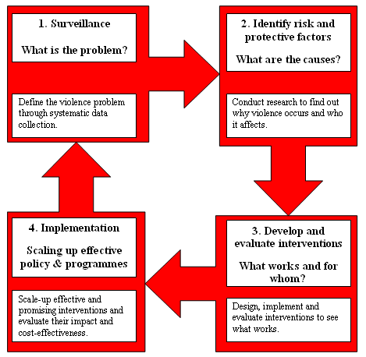
The Public Health Approach
(World Health Organization)

Slide 9
Public Health Approach in 4 Steps
To define the problem through the systematic collection of information about the magnitude, scope, characteristics and consequences of violence.
To establish why violence occurs using research to determine the causes and correlates of violence, the factors that increase or decrease the risk for violence, and the factors that could be modified through interventions.
To find out what works to prevent violence by designing, implementing and evaluating interventions.
To implement effective and promising interventions in a wide range of settings. The effects of these interventions on risk factors and the target outcome should be monitored, and their impact and cost-effectiveness should be evaluated.

Slide 10
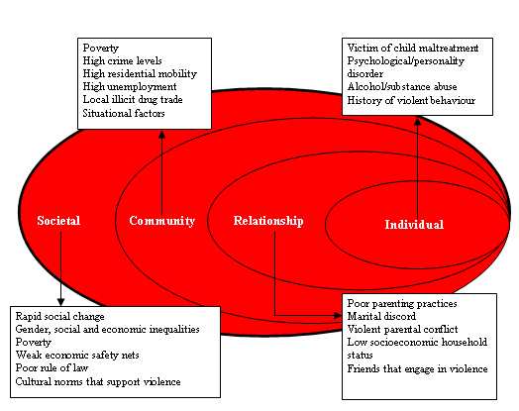
The Ecological Approach

Slide 11
The social alarm rings
The sustainability of the juvenile justice system and the realization of its social mandate are in jeopardy.
The problem is especially exacerbated in aging societies where the allocation of public resources is often biased towards the old generations at the cost of the young ones.

Slide 12
The social and justice divide
Greater divide between the northern and southern regions of Europe that are differently hit by the economic crisis both in
  Quality of our children
  Quality of the family and public care of our children
Greater justice divide both in
  E-quality of access to justice and care
  E-quality of the juvenile justice systems
Greater divide in social costs if southern societies fail to reintegrate their “about to be lost” generations

Slide 13
Main motivation of the study
In the present socioeconomic context in which not only physical but also human and social capital is highly devalued, it is urgent to single out the relative causal importance of
  individual characteristics, traits, and responsibilities,
  family background,
  income, education and unemployment, especially youth
  community circumstances
in determining youth offensive behavior in order to design youth programs effective in reducing the role of circumstances and in guaranteeing equal opportunities.

Slide 14
Main question
What
causes
juvenile crime?

Slide 15
The determinants of juvenile crime
Levitt and Lochner in “Risky Behavior among Youths: An Economic Analysis” ed. J. Gruber 2001
Biological factor
  gender
Social factors
  Quality of parenting
  Female-headed households and city crime
  Outside the family: degree of “social control” exerted by a community
Criminal justice systems: prevention and cure
  Punishment vs restorative justice
  recidivism
Economic factors: affecting the attractiveness of alternatives to crime /income+ poverty effects

Slide 16
Juvenile crime
Biological state
(gender)
Environmental conditions
Immediate causes
Intermediate causes
Social factors
Criminal Justice system
Economic factors
& crisis!
Underlying causes
Family and quality of parenting
Extended family
Comm. and proximity services
Society and public services

Slide 17
Levitt and Lochner’s conclusions
(based on correlation not causal evidence)
Individual-level analysis highlights the importance of such criminogenic factors as
  gender, family environment, and cognitive ability in predicting criminal involvement.
  unstable homes
  children in poverty and local income inequality.
criminal-justice system in restraining criminality is important.
None of these determinants of crime, however, do a particularly good job of explaining the time-series pattern of juvenile crime over the last two decades.

Slide 18
So, low private, social and human capital are preconditions to crime: but how?
Weaker families and their networks, community and proximity services, society, public services and third sector
Greater income poverty and inequality
  New poverties for our young people:
    parents,
    care,
    good adults/children relationships,
    education opportunities;
  Social diseases:
    drug and alcohol consumption, internet dependence, peer negative examples, domestic violence
Are these factors statistically significant causes of juvenile crime both against persons and property?

Slide 19
The epidemiology of juvenile crime
Lessons from Veneto and Sicily
Let us examine the risk factors that a crisis may exacerbate learning from the evidence of a recent field study conducted in Veneto and Sicily
From a policy point of view, it is an instructive North-South comparison.

Slide 20
The
case-control study
The experimental setting

Slide 21
What is a cohort study
A cohort study or panel study is a form of longitudinal study used in medicine, social science, criminology and other sciences. It is an analysis of risk factors.
It follows a group of people who initially do not have a medical or social disease and uses statistical analysis to determine the absolute risk of subject contraction.
An interesting example is the Elfe (France) case that is the first longitudinal study in France that aims to follow 20,000 French children from birth to adulthood by analysing multiple aspects of the life of the child in terms of health, environmental health and social sciences.

Slide 22
Longitudinal studies of large cohorts: the French ELFE example
The French Longitudinal Study about Infants (ELFE) observes for 20 years a cohort of 20,000 children starting from 2011 aiming at understanding how perinatal conditions and other environmental aspects such as family, socio-economic characteristics, geographic and chemical factors, and economic crises may affect the development , health and child socialization from the foetal state to adolescence.
Top topics of the ELFE study:
  Environmental aspects of children subject to major changes such as dietary changes, physical activities, new pollutants, changes in family composition and structure, increase in working mothers, job precariousness, and education careers;
  The relationships between these factors and the development of cognitive, non-cognitive, language, socio-relational abilities and deviant behaviour and conditions;
  Study of the complex relationships between biological, social and behavioural factors.
The project is multidisciplinary: more than 100 among social scientists, epidemiologists, nutritionists, physicians. It is based on a public/private partnership. Estimated cost: 7 mil Euro for the first two years, 3 mil for the following years.
Notes:
Nature and nurture of crime, intergeneration transmission of crime

Slide 23
15 main topics + crime
• Demography and family • Economics, precariousness
• Socialization, education • Psychomotor development
• Physical growth and puberty • Food, nutrition, metabolism
• Respiratory desease • Asthma and allergies
• Cancer • Accidents and trauma
• Perinatal period • Health care and dental health
• Infectious desease • Chemical exposures
• Physical exposures • Exposures to environmental contaminants

Slide 24
Comparison of the characteristics of cohort and case control observational studies
Cohort
  Complete source population
  Can calculate incidence rates or risks and their differences and ratios
  Very expensive
  Convenient for studying many diseases
  Not always observe the outcome of interest
  Can be pro or retrospective
Case-control
  Sampling from source population
  Can calculate only the ratio of incidence rates or risks (unless the control sampling fraction is known)
  Less expensive (esp. If control comes from existing data but less precise e.g. no peer effects or noncogn ab)
  Convenient for studying many exposures
  Can be pro or retrospective

Slide 25
The case-control study about juvenile crime in Veneto and Sicily
Studies about socially excluded parts of society are rare in Italy
Cases
  Representative sample: 257 obs. Sicily, 159 obs. Veneto of young offenders. We administered a questionnaire to the subject and one to their family gathering information about
    Socio-economic and psychological characteristics
    Relational aspects and social capital
    Consumption, income, intrahousehold distribution of resources and time use

Slide 26
Bayesian sampling
We analyze the ex post representativeness of the sample observed
Expected sample size weighting by population proportions is
Triveneto: 142; Sicily 235

Slide 27
Sampling Strategy
Phase I. Random data collection but without precise information about the strata of type of crimes
  The available information refer to the number of crimes and juvenile denounced by region of residence and committed crime that is not our population of interest: youth taken under care.
Phase II. From the priors of phase I, use as a cross-check both
  simple random sampling without replacement
  Mixed Bayesian/Likelihood (MBL) approach with the Average Coverage Criterion method (ACC) to calculate the required sample size to reach a given coverage probability on average for a posterior credible interval of fixed length

Slide 28
Bayesian sampling
We analyze the ex post representativeness of the sample observed
Geographical area | Type of crime | Field* (1° phase) | Final sample size* |  | Sampling design
 |  |  |  |  | Simple random sampling without replacement |  | Mixed Bayesian/Likelihood approach
 |  | % | Freq. | % | Freq. | % | Freq. | %
 |  | (a) | (b) | (c) | (e) | (f) | (g) | (h)
Triveneto | Against persons | 0.21 | 36 | 0.23 | 40 | 0.24 | 51 | 0.24
 | Against property | 0.39 | 65 | 0.41 | 59 | 0.35 | 74 | 0.35
 | Drugs | 0.35 | 50 | 0.31 | 56 | 0.34 | 71 | 0.34
 | Others | 0.05 | 8 | 0.05 | 12 | 0.07 | 15 | 0.07
 | Total | 1.00 | 159 | 1.00 | 167 | 1.00 | 211 | 1.00
Sicily | Against persons | 0.22 | 58 | 0.23 | 45 | 0.28 | 52 | 0.28
 | Against property | 0.56 | 139 | 0.54 | 65 | 0.40 | 77 | 0.41
 | Drugs | 0.16 | 36 | 0.14 | 36 | 0.22 | 41 | 0.22
 | Others | 0.06 | 23 | 0.09 | 15 | 0.09 | 18 | 0.10
 | Total | 1.00 | 256 | 1.00 | 161 | 1.00 | 188 | 1.00
Source: * Juvcrime data.

Slide 29
From the case to the control
Control
  We matched the data of
  ISTAT consumption survey,
  ISTAT living standard survey EUSILC,
  ISTAT time use survey
  CISF (Survey on Family Conditions and social capital)
  The vars in the questionnaires for the cases and the control are defined the same

Slide 30
Common Support
Observations with the same covariate values have a positive probability of being both treated and untreated
Consumption vs
Living Conditions
Social capital

Slide 31
Conditional Independence
Given a set of common covariates which are not affected by treatment, the potential outcomes are independent of treatment assignment
Components 0-5 years old | Treatment (EUSILC) |  | Untreatment (Consumption) |  | Total
 | N | Col % | N | Col % | N | Col %
No | 16951 | 88.53 | 20477 | 89.75 | 37428 | 89.19
Yes | 2196 | 11.47 | 2339 | 10.25 | 4535 | 10.81
Total | 19147 | 100 | 22816 | 100 | 41963 | 100
Components 0-5 years old | Treatment (EUSLIC) |  | Untreatment (CISF) |  | Total
 | N | Col % | N | Col % | N | Col %
No | 10783 | 84.75 | 2502 | 88.85 | 13285 | 85.49
Yes | 1940 | 15.25 | 314 | 11.15 | 2254 | 14.51
Total | 12723 | 100.00 | 2816 | 100.00 | 15539 | 100.00

Slide 32
Balance - I
Balance of propensity score across treatment and comparison groups
  The propensity score should have a similar distribution ("balance") in the treatment and comparison groups by blocks.
Balance of covariates across treatment and comparison groups within blocks of the propensity score
  After the propensity score is balanced within blocks across the treatment and comparison groups, we perform a check for balance of individual covariates across treatment and comparison group within blocks of the propensity. This ensures that the propensity score's distribution is similar across groups within each block and that the propensity score is properly specified.

Slide 33
Balance – II
(EUSILC-Consumption)
 | Blocks
 | 2 | 3 | 4 | 5 | 6 | 7 | 8 | 9 | 10 | 11 | 12
Balance of propensity score across treatment and comparison groups | -0.077 | 1.368 | 1.332 | -0.076 | -1.218 | -2.238 | -0.654 | -0.425 | -1.980 | -0.593 | -1.381
Balance of covariates across treatment and comparison groups within blocks of the propensity score
Geographical area
Northeast | -1.287 | -1.200 | 0.747 | -1.346 | 0.336 | 0.681 | 2.501 | 0.279 | 1.127 | -0.586 | -0.775
Central Italy | . | . | -0.984 | 0.576 | -0.330 | -0.104 | -2.117 | -0.254 | -0.719 | -0.840 | -0.775
Southern Italy | -0.987 | 2.089 | -2.197 | 0.194 | -1.116 | -0.561 | -2.189 | . | -0.873 | . | .
Islands | 1.471 | -1.586 | -0.961 | -0.169 | -0.731 | -0.589 | 0.033 | . | -0.873 | -0.622 | .
Components 0-5 years old | 0.591 | -0.539 | -0.717 | -0.429 | 0.036 | 0.884 | 0.483 | -1.016 | 1.029 | 1.066 | -0.775
Components 6-14 years old | 0.842 | 0.284 | 0.746 | 0.081 | -0.563 | 0.813 | -1.892 | -1.766 | 0.331 | -1.568 | -0.775
Self-employed | 1.210 | 0.907 | 0.343 | 1.842 | -1.040 | -0.768 | -0.226 | -2.346 | -0.877 | -1.031 | .
Single-parent | -0.279 | 2.350 | 0.287 | 0.627 | -1.750 | -0.062 | -0.050 | 0.357 | -0.100 | -0.048 | .
Owner occupancy | 1.121 | -1.716 | 2.048 | 0.118 | -1.077 | 2.482 | -1.434 | -0.905 | -1.465 | -2.269 | .
Avg family education -
Middle | -0.253 | 0.823 | 1.416 | 0.226 | -0.529 | 1.156 | 0.550 | -0.329 | 0.480 | -1.090 | .
Middle-High | -2.494 | 1.061 | -0.595 | 1.186 | 0.733 | -0.961 | 1.547 | -0.014 | -0.117 | -0.992 | -0.775
High | 0.685 | 1.555 | -1.714 | 1.661 | -1.370 | -0.612 | 0.042 | 0.601 | -1.080 | 0.079 | -1.549
University | -0.007 | -2.082 | -0.495 | 0.456 | 0.388 | 0.774 | -0.636 | 0.276 | 1.533 | 0.798 | .
Family income | 2.326 | 1.124 | -0.092 | 2.256 | -0.981 | 0.050 | -0.217 | -1.203 | -1.518 | -0.508 | -0.793

Slide 34
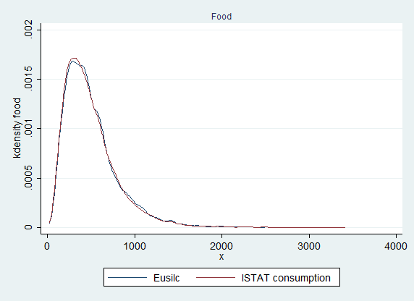
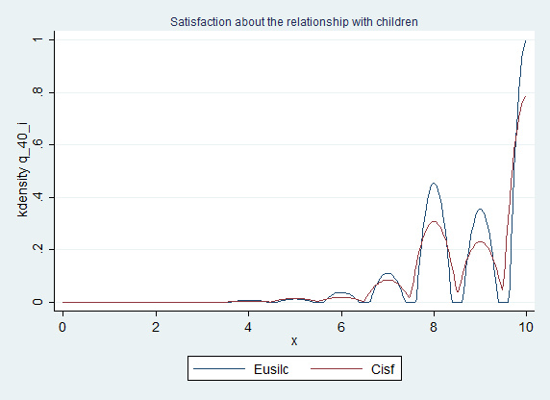
Matching: Quality Control
Consumption – Living Conditions
Satisfaction with children

Slide 35
Incidence of adult crime in Veneto and Sicily
Denounced crime and crime ratios / 100000 residents
Year 2005 Source: Istat | Crime against persons | Crime against property | Total | Crime ratio for crimes against persons | Crime ratio for crimes against property | 2005 Population
Veneto | 8.00 | 81.64 | 156249 | 263.87 | 2692.14 | 4738313
Sicily | 13.38 | 73.46 | 206556 | 551.04 | 3024.15 | 5017212
Italy | 11.57 | 76.54 | 2579390 | 508.06 | 3360.16 | 58751711

Slide 36
Incidence of juvenile crime in Veneto and Sicily
Denounced juvenile crimes and crime ratios / 100000 residents aging 14-17
Year 2007 Source: Istat | Crime against persons | Crime against property | Total | Crime ratio for crimes against persons | Crime ratio for crimes against property | 2007 Population Age 14-17
Veneto | 20.91 | 66.86 | 2224 | 133.55 | 427.09 | 348173
Sicily | 32.16 | 35.46 | 5460 | 373.96 | 412.30 | 469564
Italy | 32.00 | 48.66 | 49004 | 343.63 | 522.46 | 4563966

Slide 37
A Glance
at the
data

Slide 38
Evolution of juvenile crime during the crisis
Young people taken under care by social service

Slide 39
Distribution of crime in the Veneto and Sicily samples

Slide 40
Juvenile offense and income
Veneto
Sicily

Slide 41
Juvenile offense and parental caring (time use of the mother)

Slide 42
Juvenile Offense and Social Capital
(% high)
Trust on your family members (Bonding)
Trust on your family friends (Bridging)

Slide 43
Juvenile Offense and Relational Well-being
Satisfaction about relations with your child (% high)
Satisfaction about time spent together (% high)

Slide 44
Juvenile offense and
Human Capital - I
Degree
Actual school status
(52% simply did not want to go)

Slide 45
Juvenile offense and
Human Capital - II
Behavioral problems
at school
School performance

Slide 46
Juvenile Offense and presence of parents / working condition
Presence of parents
Working conditions

Slide 47
Intergenerational Trasmission of Crime (fathers&son): nature or nurture?

Slide 48
Juvenile Offence and Drug Addiction
Are you actually assuming drugs?
(information in the case but not in the controls)
 | Veneto |  |  | Sicily
Offense type | Yes | Not, but had drugs in the past | Never | Yes | Not, but had drugs in the past | Never
against person | 5 | 15 | 26 | 6 | 23 | 35
 | 10,87 | 32,61 | 56,52 | 9,38 | 35,94 | 54,69
 | 15,63 | 15,00 | 44,83 | 27,27 | 15,33 | 31,25
against patrimony | 15 | 29 | 27 | 12 | 79 | 54
 | 21,13 | 40,85 | 38,03 | 8,28 | 54,48 | 37,24
 | 46,88 | 29,00 | 46,55 | 54,55 | 52,67 | 48,21
Violation narcotics law | 6 | 50 | 3 | 2 | 32 | 11
 | 10,17 | 84,75 | 5,08 | 4,44 | 71,11 | 24,44
 | 18,75 | 50,00 | 5,17 | 9,09 | 21,33 | 9,82
Others | 6 | 6 | 2 | 2 | 16 | 12
 | 42,86 | 42,86 | 14,29 | 6,67 | 53,33 | 40,00
 | 18,75 | 6,00 | 3,45 | 9,09 | 10,67 | 10,71
Total | 32 | 100 | 58 | 22 | 150 | 112
 | 16,84 | 52,63 | 30,53 | 7,75 | 52,82 | 39,44
 | 32 | 100 | 100 | 22 | 150 | 100

Slide 49
Juvenile Offenses and associated consequences I
Job loss
Economic troubles

Slide 50
Juvenile Offenses and associated consequences II
Change in time use
Separation

Slide 51
Juvenile Offenses and associated consequences III

Slide 52
What is the role of family and society’s circumstances?
How do (poverty) circumstances differ
between Veneto and Sicily?

Slide 53
Child poverty approaches
(Roelen and Gassmann 2008)
One dimensional measure of child poverty
  Poverty of what?
Household as a unit of analysis
Exclusion of vulnerable groups not covered by household surveys

Slide 54
Distribution of equivalent income in Veneto and Sicily – case vs control
Veneto
(Gini: .272 case,.269 control)
Sicily
(Gini: .291case,.313 control)

Slide 55
Multidimensional poverty in Veneto and Sicily’s sample of young offenders
The multidimensional poverty index (MPI) reflects deprivations in basic services and human functionings associated with Human Development. Not just income.
The MPI has traditionally three equally weighted dimensions:
  (e.g. health, education, and standard of living).
  A household is identified as MP if it is deprived in some combination of indicators whose weighted sum exceeds 30 percent of deprivations.
  The MPI is the product of two measures:
    Headcount, % of people who are poor, and
    Average Intensity of Deprivation reflecting the proportion of dimensions in which households are deprived. So MPI is an adjusted measure of the incidence of poverty H.

Slide 56
Dimensions of poverty
Dimension | Description | Poverty line
Income | Equivalent household income | Half the median value of equivalent income (EUSILC)
No of parents | Number of parents in the household | A family with single-parent
Relation with children | Satisfaction about the relationship with children (range 0-10) | Less than six
Crime area | The family lives or not in an area that presents problems of crime, violence or vandalism | Family lives in a crime area
Education | Education of parents and children dropout | Low education of parents and at least one child has dropout
Parents work | Both parents (or single-parent) working or not full time | Both parents (or single-parent) working full time

Slide 57
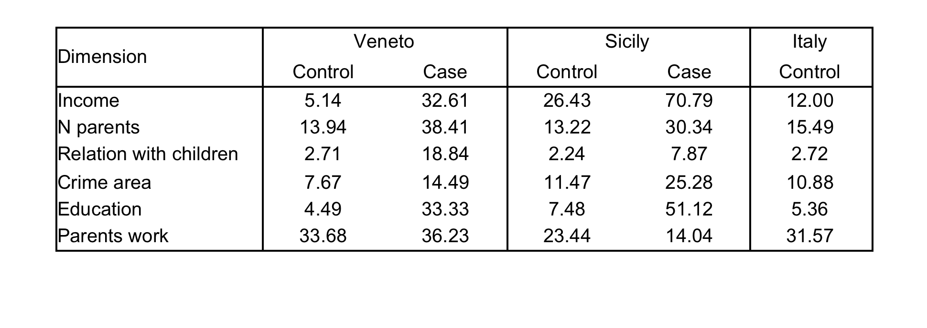
Proportion of poor in each dimension

Slide 58
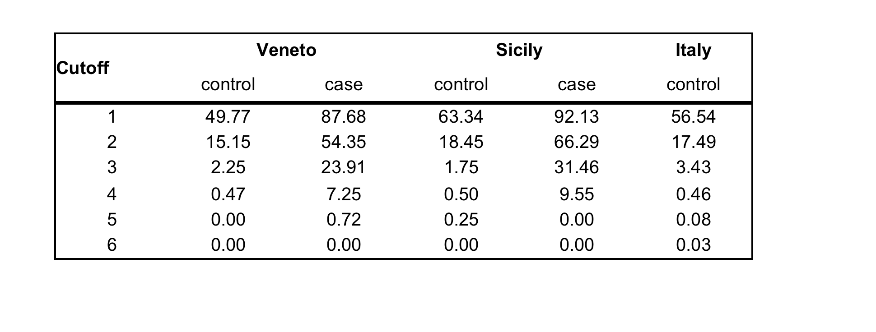
Multidimensional poverty headcount ratio (H0) for different values of k

Slide 59
Contribution of each dimension at k=3 (Adjusted headcount ratio M0)

Slide 60
The
case-control study
Results

Slide 61
The case-control study
Odds Ratio
The odds ratio (OR) is one of the indices used in case-control retrospective studies to define the cause-effect ratio between two factors, e.g. a risk factor and a disease or an offense in our case.
The OR compares the occurrence frequency of an event (e.g. a disease or crime) respectively in the exposed subjects (who committed a crime) and in those non exposed to the risk factor of interest.
The OR is defined as the odds of the social problem (disease) between exposed subjects divided by the odds of the problem among non exposed subjects.
  If OR=1, the odds in the control is equal to the odds of the exposed cases, that is the risk factor does not affect the occurrence of the problem;
  If OR>1, then the risk factor can be a cause of the problem;
  If OR<1, then the risk factor is in effect a defense against the problem.

Slide 62
The attributable fraction - AF
AF: the proportion of disease burden causally explained by, or attributable to, the risk factor(s) being considered.
AF: the proportion of disease risk that would be eliminated from the population if exposure to the risk factor were eliminated.

Slide 63
Degree of exposure to risk factors
 | Triveneto |  |  | Sicily
 | % Exposed |  |  | % Exposed
Risk factors | Case | Control |  | Case | Control
Income | 0.76 | 0.38 |  | 0.94 | 0.72
Single or no parent | 0.38 | 0.14 |  | 0.30 | 0.13
Education | 0.65 | 0.59 |  | 0.85 | 0.62
At least one child drop-out | 0.43 | 0.06 |  | 0.55 | 0.08
Working father | 0.81 | 0.79 |  | 0.63 | 0.78
Working mother | 0.67 | 0.60 |  | 0.26 | 0.30

Slide 64
Young offense and income, family structure, human capital and work condition
 | Triveneto |  |  | Sicily
Causes | Odds Ratio | Attr. Frac. Ex. | 2-sided Fisher's exact P | Odds Ratio | Attr. Frac. Ex. | 2-sided Fisher's exact P
Income | 5.28 | 0.81 | 0,000 | 6.59 | 0.85 | 0,000
Single or no parent | 3.85 | 0.74 | 0,000 | 2.86 | 0.65 | 0,000
Education | 1.28 | 0.22 | 0.2297 | 3.65 | 0.73 | 0.0000
At least one child drop-out | 11.88 | 0.92 | 0.0000 | 13.22 | 0.92 | 0.0000
Working father | 1.13 | 0.11 | 0.7900 | 0.49 | 0.51 | 0.0015
Working mother | 1.36 | 0.26 | 0.1465 | 0.80 | 0.20 | 0.3122

Slide 65
Young offense and income
 | Triveneto |  |  | Sicily
 | Odds Ratio | Attr. Frac. Ex. | 2-sided Fisher's exact P | Odds Ratio | Attr. Frac. Ex. | 2-sided Fisher's exact P
Violent crime - Income | 11,2 | 0,91 | 0,0000 | 3,43 | 0,71 | 0,0135
Property crime - Income | 5,49 | 0,82 | 0,0000 | 12,42 | 0,92 | 0,0000
Drugs - Income | 3,96 | 0,75 | 0,0000 | 3,53 | 0,72 | 0,1192

Slide 66
Young offense, social capital and relational well-being
 | Triveneto |  |  | Sicily
 | Odds Ratio | Attr. Frac. Ex. | 2-sided Fisher's exact P | Odds Ratio | Attr. Frac. Ex. | 2-sided Fisher's exact P
Trust in family members for daily necessities (bonding) | 14,58 | 0,93 | 0,0000 | 2,04 | 0,51 | 0,0264
Trust in friends of family members (bridging) | 1,78 | 0,44 | 0,0015 | 3,64 | 0,73 | 0,0000
Satisfaction about the relationship with children | 8,33 | 0,88 | 0,0000 | 3,72 | 0,73 | 0,0022
Satisfaction about the time spent together | 6,41 | 0,84 | 0,0000 | 3,07 | 0,67 | 0,0002

Slide 67
Young offense, social capital and relational well-being
 | Triveneto |  |  | Sicily
 | Odds Ratio | Attr. frac. ex. | 2-sided Fisher's exact P | Odds Ratio | Attr. frac. ex. | 2-sided Fisher's exact P
Crime – trust in family members for daily necessities (bonding) | 9.77 | 0.90 | 0.0000 | 9.23 | 0.89 | 0.0000
Crime – trust in friends of family members (bridging) | 2.14 | 0.53 | 0.0001 | 2.66 | 0.62 | 0.0000
Crime – satisfaction about the relationship with children | 8.96 | 0.89 | 0.0000 | 2.64 | 0.62 | 0.0002
Crime – satisfaction about the time spent together | 2.44 | 0.59 | 0.0000 | 1.29 | 0.23 | 0.1225

Slide 68
After the separate effects,
the joint causal effects

Slide 69
Variable Definition
Family size |  | Number of family members
Age (hh head) |  | Household head's age in years
Citizenship (hh head) |  | = 1 if hh head has Italian citizenship
Only child |  | = 1 if family with one child
Single parent |  | = 1 if single parent family
Father highest degree
 | Elementary | =1 if elementary school certificate
 | Middle school | = 1 if middle school certificate
 | High school | = 1 if high school certificate
 | University | = 1 if university degree
 | Missing (no father) | = 1 if no education information because there is no father
Mother highest degree
 | Elementary | =1 if elementary school certificate
 | Middle school | = 1 if middle school certificate
 | High school | = 1 if high school certificate
 | University | = 1 if university degree
 | Missing (no mother) | = 1 if no education information because there is no mother
Dropout |  | = 1 if at least one child drops out from school
Father working status |  | = 1 if father works
Mother working status |  | = 1 if mother works
Neighbourhood with crime |  | = 1 if neighbourhood has criminal problems
Homeownership |  | = 1 if family owns the house either outright or through a mortgage
Family income
 | Lower class | = 1 if first tertile
 | Middle class | = 1 if second tertile
 | Upper class | = 1 if third tertile
Trust family |  | Trust in family members - Likert scale 0-10
Trust friends |  | Trust in friends - Likert scale 0-10
Generalized trust |  | People are trustworthy - Likert scale 0-10
Satisfaction with children |  | Parents' satisfaction with children relationship - Likert scale 0-10

Slide 70
Descriptive Statistics - Triveneto
TriVeneto
 |  | Control |  |  | Case
No. of observations (%) |  | 1,069 | (88.57) |  | 138 | ( 11.43)
 |  | Mean | S.D. |  | Mean | S.D.
Family size |  | 3.536 | 0.833 |  | 3.877 | 1.535
Age (hh head) |  | 50.387 | 9.137 |  | 48.572 | 8.205
Citizenship (hh head) |  | 0.960 | 0.197 |  | 0.746 | 0.437
Only child |  | 0.453 | 0.498 |  | 0.333 | 0.473
Single parent |  | 0.139 | 0.347 |  | 0.384 | 0.488
Father education
 | Elementary | 0.107 | 0.309 |  | 0.058 | 0.235
 | Middle school | 0.282 | 0.450 |  | 0.290 | 0.455
 | High school | 0.405 | 0.491 |  | 0.283 | 0.452
 | University | 0.207 | 0.405 |  | 0.370 | 0.484
 | Missing (no father) | 0.117 | 0.321 |  | 0.326 | 0.470
Mother education
 | Elementary | 0.107 | 0.309 |  | 0.109 | 0.312
 | Middle school | 0.303 | 0.460 |  | 0.341 | 0.476
 | High school | 0.466 | 0.499 |  | 0.370 | 0.484
 | University | 0.124 | 0.330 |  | 0.181 | 0.387
 | Missing (no mother) | 0.022 | 0.148 |  | 0.087 | 0.283
Dropout |  | 0.061 | 0.239 |  | 0.435 | 0.498
Father working status |  | 0.695 | 0.461 |  | 0.543 | 0.500
Mother working status |  | 0.590 | 0.492 |  | 0.616 | 0.488
Working mother and single |  | 0.090 | 0.286 |  | 0.239 | 0.428
Neighbourhood with crime |  | 0.077 | 0.266 |  | 0.145 | 0.353
Homeownership |  | 0.792 | 0.406 |  | 0.536 | 0.501
Family income
 | Lower class | 0.192 | 0.394 |  | 0.630 | 0.484
 | Middle class | 0.385 | 0.487 |  | 0.254 | 0.437
 | Upper class | 0.423 | 0.494 |  | 0.116 | 0.321
Trust family |  | 9.167 | 1.120 |  | 7.804 | 2.092
Trust friends |  | 7.223 | 2.094 |  | 5.761 | 2.701
Generalized trust |  | 5.977 | 1.540 |  | 5.290 | 2.438
Satisfaction with children |  | 9.022 | 1.058 |  | 7.428 | 2.267

Slide 71
Descriptive Statistics - Sicily
Sicily
 |  | Control |  |  | Case
No. of observations (%) |  | 401 | (69.26) |  | 178 | (30.74)
 |  | Mean | S.D. |  | Mean | S.D.
Family size |  | 3.731 | 0.907 |  | 4.084 | 1.319
Age (hh head) |  | 51.122 | 9.925 |  | 47.084 | 7.994
Citizenship (hh head) |  | 0.990 | 0.100 |  | 0.961 | 0.195
Only child |  | 0.344 | 0.476 |  | 0.191 | 0.394
Single parent |  | 0.132 | 0.339 |  | 0.303 | 0.461
Father education
 | Elementary | 0.170 | 0.376 |  | 0.270 | 0.445
 | Middle school | 0.367 | 0.482 |  | 0.348 | 0.478
 | High school | 0.267 | 0.443 |  | 0.073 | 0.261
 | University | 0.197 | 0.398 |  | 0.309 | 0.463
 | Missing (no father) | 0.110 | 0.313 |  | 0.292 | 0.456
Mother education
 | Elementary | 0.190 | 0.392 |  | 0.354 | 0.480
 | Middle school | 0.359 | 0.480 |  | 0.427 | 0.496
 | High school | 0.347 | 0.476 |  | 0.146 | 0.354
 | University | 0.105 | 0.307 |  | 0.073 | 0.261
 | Missing (no mother) | 0.022 | 0.148 |  | 0.045 | 0.208
Dropout |  | 0.085 | 0.279 |  | 0.551 | 0.499
Father working status |  | 0.691 | 0.463 |  | 0.444 | 0.498
Mother working status |  | 0.297 | 0.457 |  | 0.247 | 0.433
Working mother and single |  | 0.057 | 0.233 |  | 0.112 | 0.317
Neighbourhood with crime |  | 0.115 | 0.319 |  | 0.253 | 0.436
Homeownership |  | 0.713 | 0.453 |  | 0.427 | 0.496
Family income
 | Lower class | 0.504 | 0.501 |  | 0.916 | 0.279
 | Middle class | 0.334 | 0.472 |  | 0.056 | 0.231
 | Upper class | 0.162 | 0.369 |  | 0.028 | 0.166
Trust family |  | 9.307 | 1.161 |  | 8.472 | 2.161
Trust friends |  | 6.970 | 1.883 |  | 4.702 | 3.384
Generalized trust |  | 5.835 | 1.780 |  | 4.685 | 2.977
Satisfaction with children |  | 9.309 | 1.034 |  | 8.742 | 1.785

Slide 72
Causal effects (Odds Ratio - Triveneto): family circumstances and education
 | Model 1 | Model 2 | Model 3
Family size | 1.977*** | 2.290*** | 2.562***
 | (0.340) | (0.433) | (0.529)
Age (hh head) | 1.028** | 1.060*** | 1.064***
 | (0.0146) | (0.0171) | (0.0202)
Citizenship (hh head) | 0.167*** | 0.254*** | 0.336**
 | (0.0595) | (0.0931) | (0.147)
Only child | 1.469 | 1.557 | 1.459
 | (0.499) | (0.593) | (0.608)
Single parent | 10.13*** | 6.074*** | 7.388***
 | (4.617) | (3.208) | (4.305)
Father education - ref. group "Elementary"
Middle school | 1.672 | 1.370 | 1.656
 | (0.798) | (0.641) | (1.033)
High school | 1.248 | 1.573 | 2.654
 | (0.603) | (0.725) | (1.589)
University | 1.016 | 1.170 | 1.913
 | (0.560) | (0.661) | (1.359)
Mother education - ref. group "Elementary"
Middle school | 1.555 | 1.493 | 1.258
 | (0.661) | (0.652) | (0.705)
High school | 1.118 | 1.099 | 1.190
 | (0.481) | (0.475) | (0.643)
University | 1.487 | 2.066 | 1.651
 | (0.735) | (1.117) | (1.018)
Dropout | 8.587*** | 8.301*** | 9.213***
 | (2.259) | (2.295) | (2.963)
Father working status | 1.438 | 2.067* | 3.367***
 | (0.480) | (0.766) | (1.323)
Mother working status | 1.646** | 2.770*** | 2.482***
 | (0.404) | (0.743) | (0.794)
Neighbourhood with crime | 2.431*** | 2.129** | 1.636
 | (0.837) | (0.817) | (0.682)
Homeownership | 0.612** | 0.827 | 0.878
 | (0.150) | (0.211) | (0.246)

Slide 73
Causal effects (Odds Ratio): income and social capital
Family income - ref. group "Lower class"
Middle class |  | 0.192*** | 0.194***
 |  | (0.0523) | (0.0583)
Upper class |  | 0.0660*** | 0.0609***
 |  | (0.0258) | (0.0281)
Trust family |  |  | 0.747***
 |  |  | (0.0699)
Trust friends |  |  | 0.909*
 |  |  | (0.0483)
Generalized trust |  |  | 0.893*
 |  |  | (0.0591)
Satisfaction with children |  |  | 0.553***
 |  |  | (0.0602)
No. of observations | 1207 | 1207 | 1207
Pseudo Adjusted R2 | 0.235 | 0.302 | 0.418
Robust standard errors in parentheses.
* p<0.1, ** p<0.05, *** p<0.01.

Slide 74
Causal effects (Odds Ratio - Sicily): family circumstances and education
 | Model 1 | Model 2 | Model 3
Family size | 1.284 | 1.276 | 1.263
 | (0.239) | (0.241) | (0.248)
Age (hh head) | 0.947*** | 0.968** | 0.958**
 | (0.0133) | (0.0148) | (0.0167)
Citizenship (hh head) | 0.386 | 0.502 | 0.655
 | (0.306) | (0.379) | (0.540)
Only child | 0.827 | 0.628 | 0.641
 | (0.329) | (0.267) | (0.305)
Single parent | 1.867 | 0.626 | 0.693
 | (1.004) | (0.459) | (0.538)
Father education - ref. group "Elementary"
Middle school | 0.978 | 1.058 | 0.770
 | (0.328) | (0.372) | (0.308)
High school | 0.544 | 0.765 | 0.813
 | (0.247) | (0.356) | (0.427)
University | 0.965 | 2.503 | 2.185
 | (0.494) | (1.753) | (1.565)
Mother education - ref. group "Elementary"
Middle school | 0.789 | 0.766 | 0.679
 | (0.254) | (0.247) | (0.244)
High school | 0.421** | 0.414** | 0.275***
 | (0.164) | (0.166) | (0.120)
University | 0.650 | 1.216 | 1.029
 | (0.312) | (0.675) | (0.598)
Dropout | 7.388*** | 8.251*** | 8.651***
 | (2.057) | (2.380) | (2.630)
Father working status | 0.337*** | 0.415*** | 0.455**
 | (0.105) | (0.129) | (0.162)
Mother working status | 1.176 | 2.339** | 1.733
 | (0.349) | (0.839) | (0.635)
Neighbourhood with crime | 2.048** | 2.353*** | 1.878*
 | (0.618) | (0.737) | (0.641)
Homeownership | 0.894 | 1.091 | 1.280
 | (0.225) | (0.295) | (0.365)

Slide 75
Causal effects (Odds Ratio): income and social capital
Family income - ref. group "Lower class"
Middle class |  | 0.0947*** | 0.108***
 |  | (0.0389) | (0.0454)
Upper class |  | 0.0699*** | 0.138**
 |  | (0.0715) | (0.135)
Trust family |  |  | 0.863
 |  |  | (0.0883)
Trust friends |  |  | 0.806***
 |  |  | (0.0461)
Generalized trust |  |  | 0.941
 |  |  | (0.0620)
Satisfaction with children |  |  | 0.794**
 |  |  | (0.0851)
No. of observations | 579 | 579 | 579
Pseudo Adjusted R2 | 0.259 | 0.322 | 0.374
Robust standard errors in parentheses.
* p<0.1, ** p<0.05, *** p<0.01.

Slide 76
Causal effects (Logit): family circumstances and education
 | VENETO | SICILY | S vs V
Family size | 2.186*** | 1.220 | 1.792*
Dropout | 1.962 | 1.683 | 1.166
Only child | 0.852 | 0.463 | 1.839
Single parent | 5.196** | 0.912 | 5.700*
Owner occupancy | 0.751 | 0.988 | 0.760
Mother education - ref. group "elementary"
Middle | 0.988 | 0.681 | 1.451
High school | 0.553 | 0.247** | 2.240
University | 0.958 | 0.467 | 2.050
Father education - ref. group "elementary"
Middle | 1.151 | 0.572 | 2.012
High school | 1.399 | 0.467 | 2.996
University | 0.681 | 0.914 | 0.744
Citizenship (=1 if Italian) | 0.264* | 0.772 | 0.342
Age | 1.068** | 0.952* | 1.122***
Working father | 2.326* | 0.437* | 5.323*
Working mother | 3.368** | 2.289* | 1.471
Envir_crime | 2.070* | 2.251* | 0.919

Slide 77
Causal effects (Logit): income and social capital
 | VENETO | SICILY | S vs V
Quintile of hh income
Second quintile | 0.388* | 0.365** | 0.00420*
Third quintile | 0.0854*** | 0.0498*** | 0.00679
Fourth quintile | 0.0689*** | 0.193** | 0.00141*
Fifth quintile | 0.0213*** | 0.120 | 0.000701*
Social capital
Trust in family members | 0.836* | 0.891 | 0.938
Trust in friends | 1.034 | 0.808*** | 1.281**
Generalised trust | 0.866* | 0.944 | 0.917
Volontariness | 0.890 | 1.071 | 0.831
Satisf. with children relation | 0.555*** | 0.954 | 0.582***

Slide 78
Summary of results
Household income with both violent and, with a higher probability, property crime
Education level of the parents
Non intact households with only a single parent
Social capital in terms both of trust on family members and friends of family members
Quality of relationships within the household in terms of both the level of satisfaction about the relationship with children and time spent together.

Slide 79
Major lesson to be learned
Economic crises, in addition to reductions in public expenditures for social services, can affect a child or adolescent through a variety of settings, including the family, the school, and the community.
The loss of family income, or wealth, that may result from an economic crisis is but one among the many pathways through which children and youth may be affected.

Slide 80
Better data for evidence based policies and practices!
In practice it is crucial to accurately identify the most important constraints affecting households and individuals within households through time.
And more detailed information about parental stress, family coping strategies, income fluctuations and work status, and investments of time, as well as of financial resources in the human capital of their children, should be taken into account
… possibly within a cohort framework.

Slide 81
After the etiology …
better prevention, diversion and cures via community sanctions to realise youth potential

Slide 82
Prevention
“Neglecting the human capital of the young generation is costly for the individual and society. The WB” (e.g. increase in risky behaviors such as substance abuse and delinquency)
Household Support Programs (Family relational well-being and bonding SC): Interventions that encourage positive development of adolescents
  Adapt income transfer programs to support healthy parent-child relationships and convey productive messages.
Support Positive Relationships with Adults Outside the Family (Trust and Bridging SC)
  Establish mentoring relationships with adults in community, school, and work settings (Adolescents seek adult role models outside their family context).
Leveraging the School as a Protective Setting :
  Prevent youth from dropping out of school and encourage continued education and training.
Supporting Adolescents’ Transition to Work
  Enhance young people’s connection to the labor market during the transition to work.

Slide 83
Diversion
The majority of children who commit an offence will do so once: 90% are first-time offenders and 80% will never be in conflict with the law again.
Diversion policies aimed at rebuilding family and community ties have a very positive impact on the child, the victim and the community.
Diversion is cost-effective, it is non-stigmatising and reduces the likelihood of children reoffending.
But still costs and is mainly under NGO’s cofunded by the State … bank foundations help only in Northern Italy

Slide 84
Community sanctions
Target investments in schools or community programs where many children can be reached at once to mitigate some of the negative effects experienced within the family.
  MST (Multi-systemic therapy involving family, school, peers)
  FFT (Functional family therapy – family focused programme aiming at reducing risk factors and recidivism)
Program monitoring and evaluation in terms of reduced incidence of crime and recidivism
Again, very costly …

Slide 85
An istitutional view: a costless cure
Policy objectives
  Stronger families (female-headed hhs strong predictor of city crime rate) and higher quality of parenting
  Stronger communities
How? Investing in institutional innovations such as
  Better laws without perverse incentives for families to break
  Fund community foundations: the State is moneyless, communities are better endowed with money, time, knowledge readily available to meet the needs of their own children and youth and to implement prevention, diversion and community sanctions effectively.

Slide 86

Thanks!

